Slide 1

PRINCIPLES OF
DATABASE MANAGEMENT
Semester 2, 2020-2021
Lecturer: assoc. prof. Nguyen thi thuy loan
Topic 2: sentiment analysis for product rating

Slide 2



“Múcgang” Team
Nguyen Thi Hoai An
Nguyen Lam
Phan Anh Ngoc
ITDSIU18024
ITITIU18255
(Team Leader)
ITITWWE19018

Slide 3

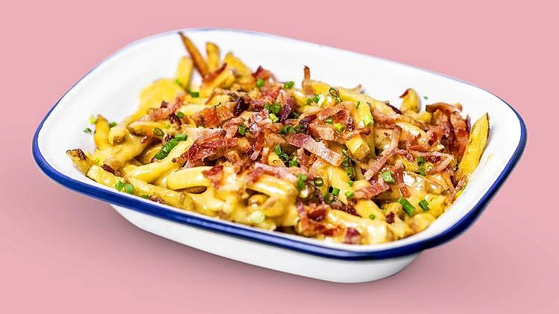

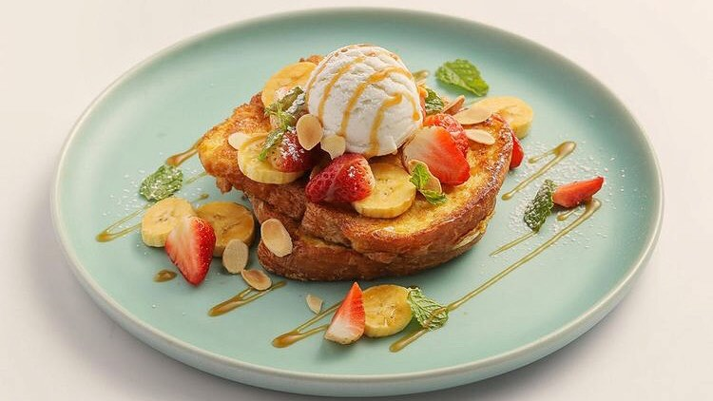
Agenda
About the project
ER Diagram
Database Design
Demo

Slide 4
I. About the project
Múcbang (wordplay of Mukbang: Eating show in Korea) is a food and drinks destinations rating website

Slide 5




How Múcbang works
User:
Leave comments with sentiment words
Ratings:
Trust-worthy reference for those who seek cafeterias reviews
System:
Calculate ratings based on sentiment words in users’ comments

Slide 6



II. ER Diagram

Slide 7
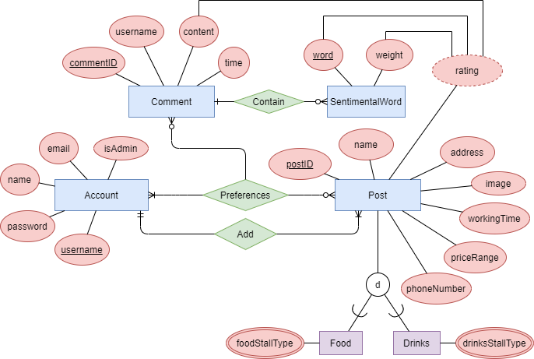
ER Diagram

Slide 8
III. Database Design

Slide 9
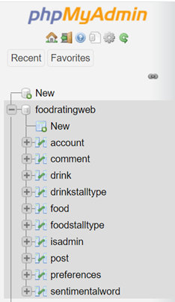
Database Design
ER Diagram

Slide 10
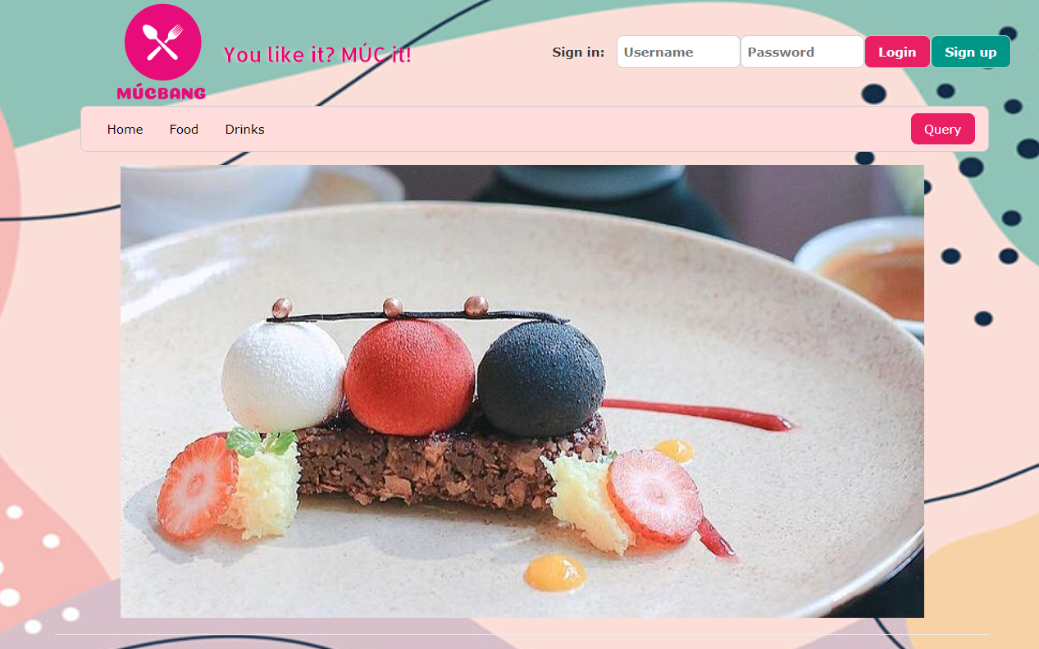

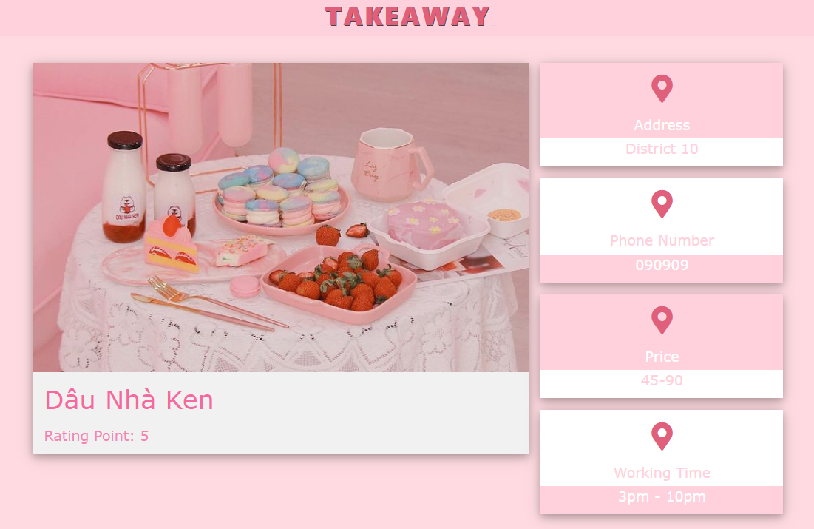
IV. Demo

Slide 11


Thank you

